Slide 1
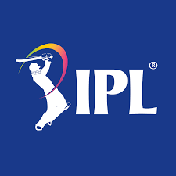




BY: PALLAVI THAKUR
C37 BATCH
DA/BI

Slide 2

As a data analyst at IFP, a nationally recognized news agency, which is based out of New Delhi, and provides news reports and feeds to magazines, newspapers and TV broadcasters all over the country.
1. Match Statistics
Toss outcome vs Match outcome (for each Ground/Venue)
Biggest wins (by runs and by wicket)
Highest totals (across all the seasons)
2. Player Statistics
Orange Cap contenders (The batsmen who have scored the maximum number of runs in a particular season)
Purple Cap contenders (The bowlers who have taken the maximum number of wickets in a particular season)
Batsmen who have hit the most number of fours and sixes (per season and overall)
3. Team Statistics
Season-wise team performance (wins vs losses)
Win %age ( home vs away)

Slide 3
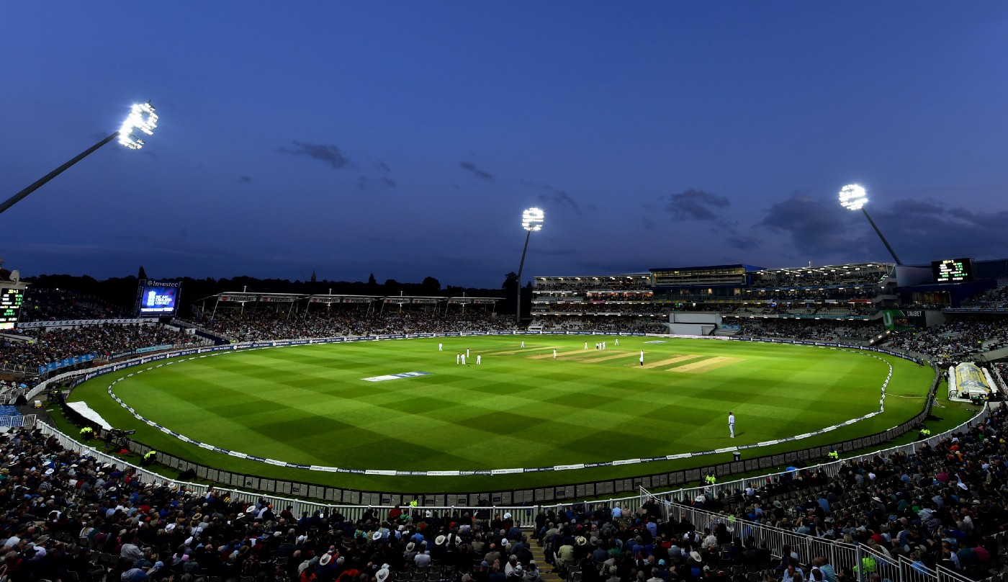

Slide 4
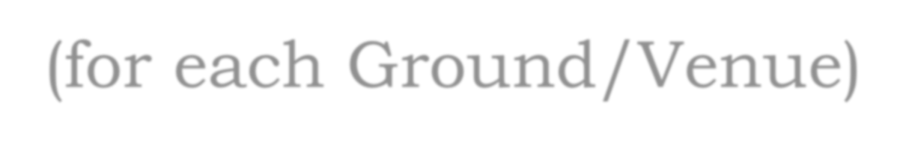
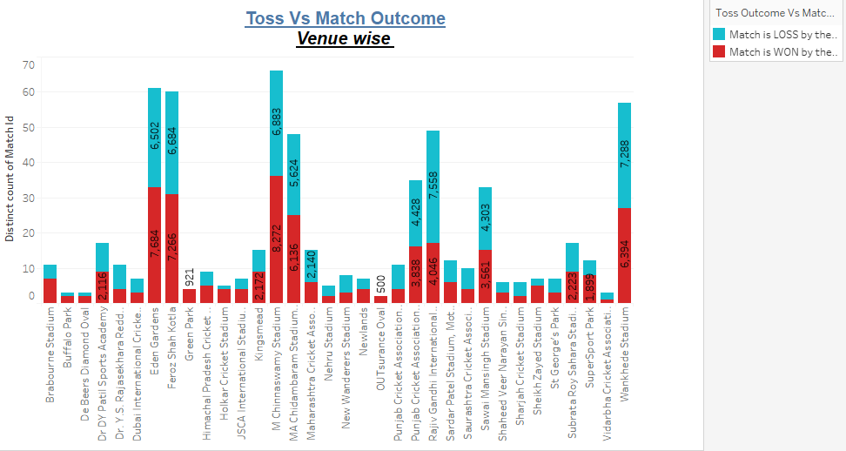
M Chinnaswamy Stadium has the maximum win where the team has won the toss; it has won 8272 matches where the team
had won the toss.
Wankhede Stadium had the maximum loss even though the team had won the toss their.

Slide 5


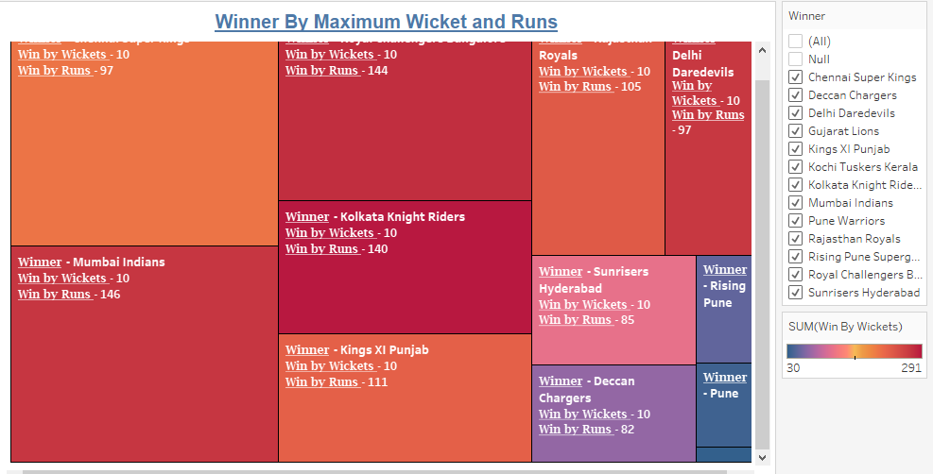
Mumbai Indians are the best performer with a maximum run of 146 and 10 wickets
Gujarat Lions haven’t performed well as they a maximum run of 1 and 7 wickets.

Slide 6

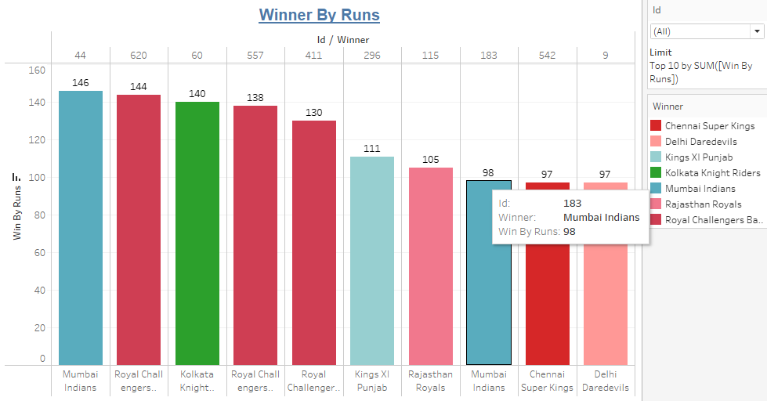
Mumbai Indians has the highest win score with runs of 146 for the match id 44.

Slide 7
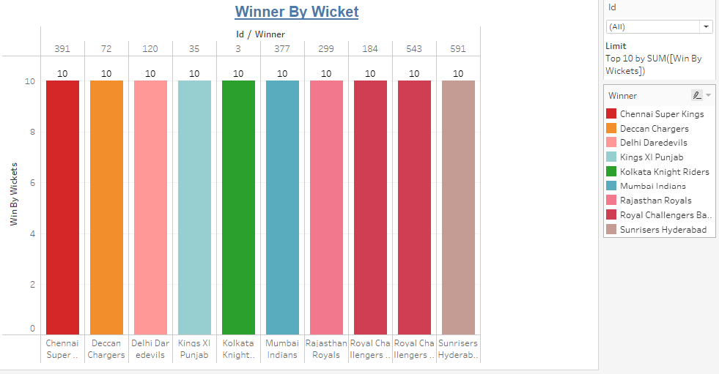
All teams EXCEPT Gujarat Lions ,Rising Pune Supergiants ,Kochi Tuskers Kerala ,Pune Warriors has won at least 1 match with 10 wickets.
Royal Challengers Bangalore has won 2 matches with 10 wickets.

Slide 8
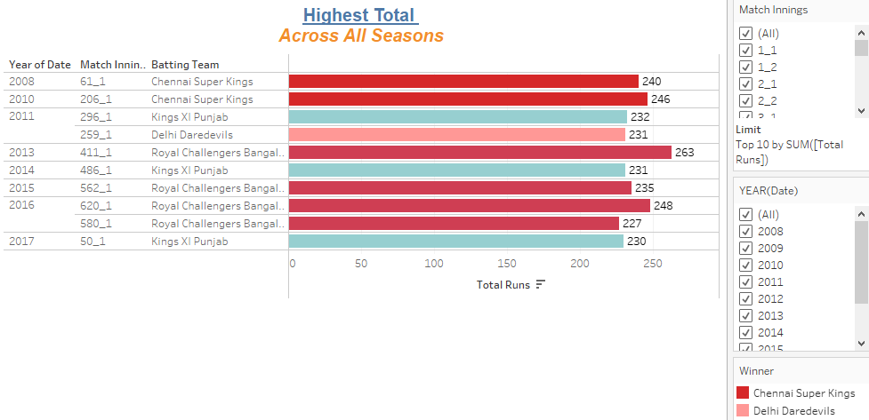
HIGHEST TOTAL(across all the seasons)
In the year 2013 Royal Challengers have given the best performance with highest total of 263.

Slide 9
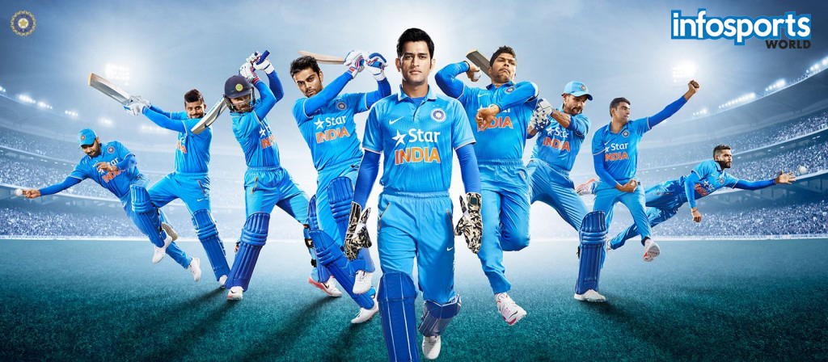


Slide 10
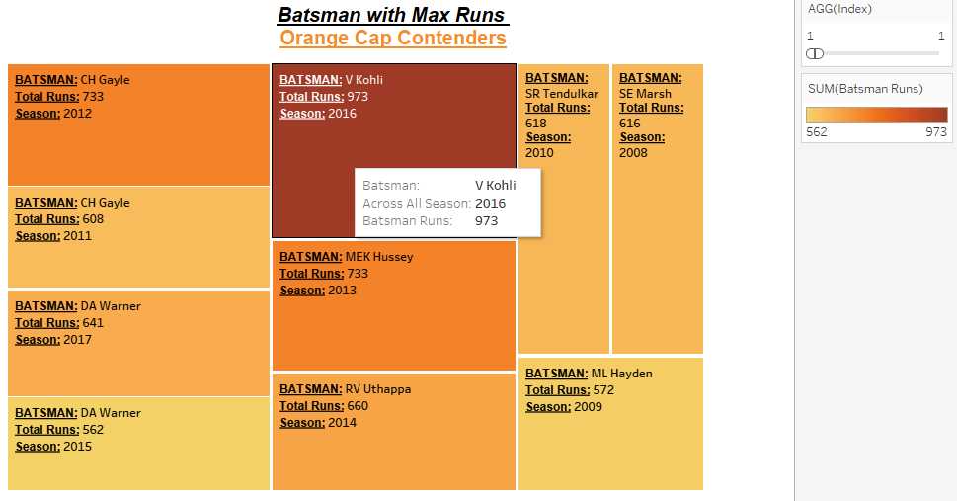
Orange Cap Contenders
From all Orange Cap Contenders Virat Kholi has scored the maximum runs of 973 in the year 2016.

Slide 11
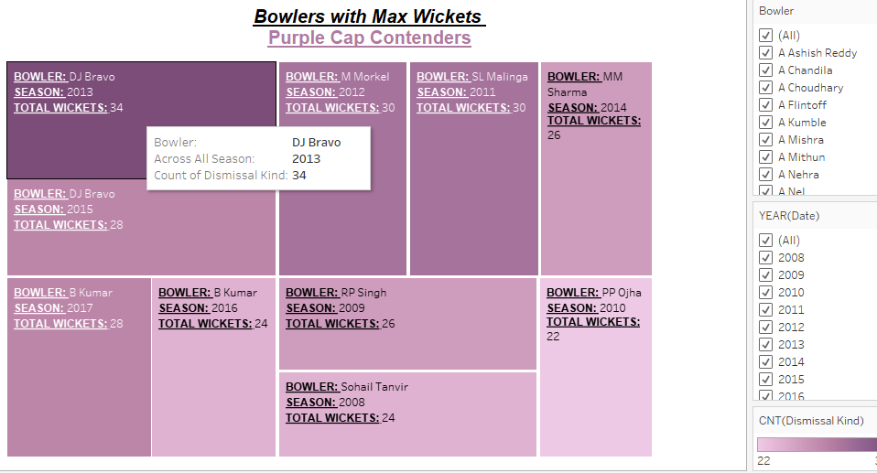
Purple Cap Contenders

Slide 12
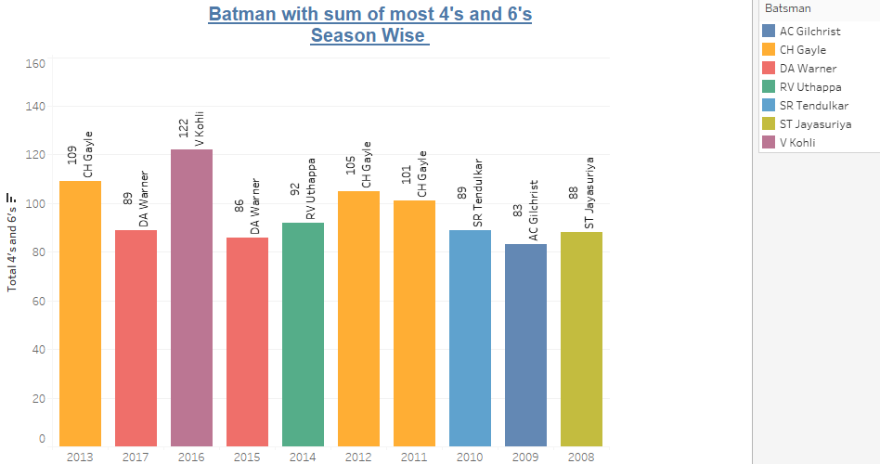
ST Jayasuriya has scored the highest number of 4’s and 6’s across all seasons.

Slide 13
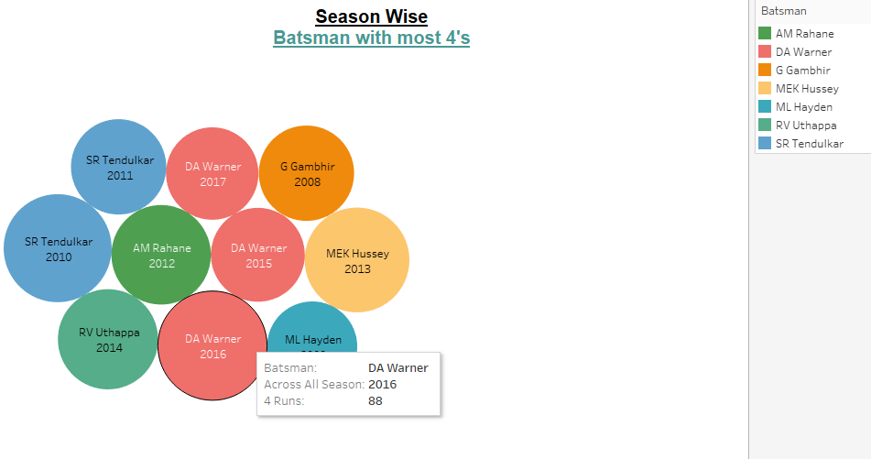
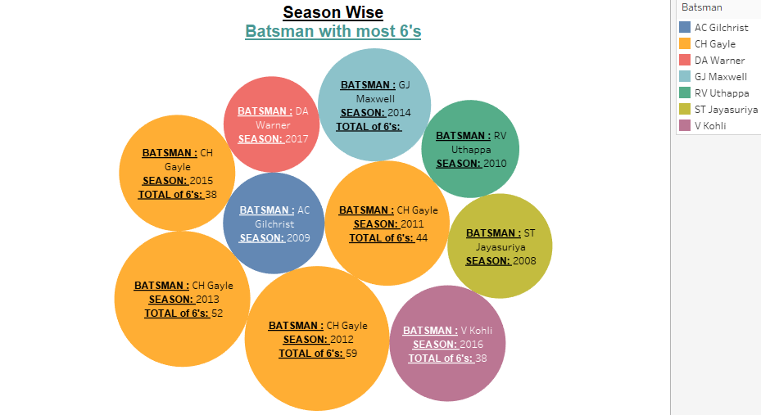
Season wise Batsman with most 4’s and 6’s
Across all seasons DA Warner scored the highest 4’s.
Across all seasons Chris Gayle has been given highest 6’s in the year 2011, 2012, 2013 and 2015.

Slide 14
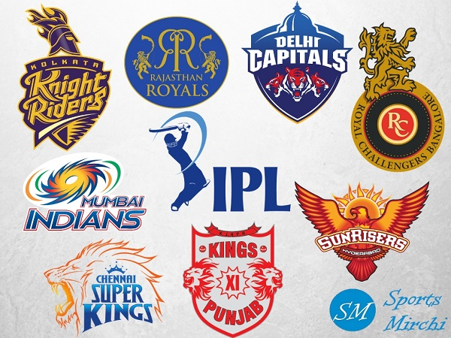





Slide 15
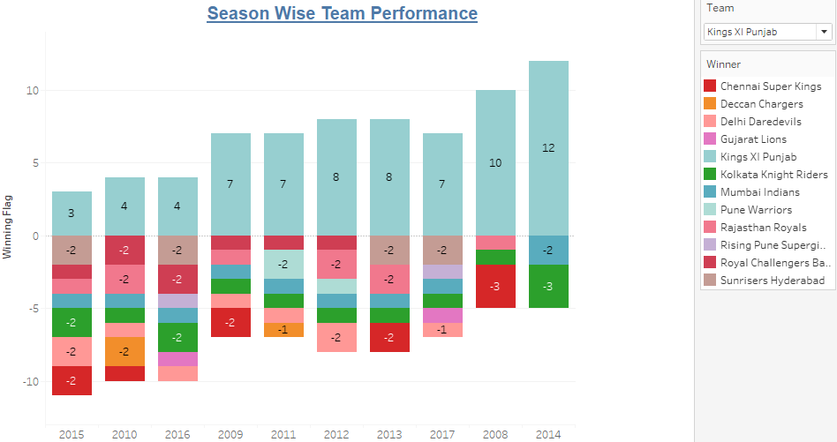
Season-wise team performance (wins vs losses)
Considering all the teams looks like Chennai Super kings has been a consistent performer with more amount of wins than loss
Where as Mumbai Indians has 3 consecutive wins.

Slide 16
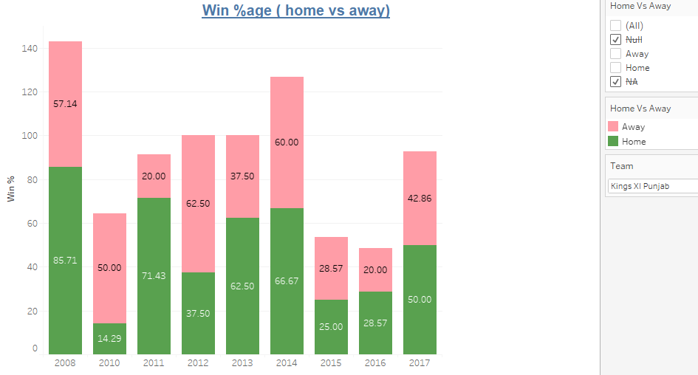
Win %age( home vs away)
Mumbai Indians have been the only team with 100% win away from home across all the season and Chennai Super Kings has given 100% win in the home stadium in the year 2011.

Slide 17

M Chinnaswamy Stadium has the maximum win where the team has won the toss; it has won 8272 matches where the team had won the toss. Wankhede Stadium had the maximum loss even though the team had won the toss their.
Mumbai Indians have had the best performer with a maximum run of 146 and 10 wickets whereas Gujarat Lions haven’t performed well as they a maximum run of 1 and 7 wickets.
In the year 2013 Royal Challengers have given the best performance with highest total of 263.
Amongst all Orange Cap Contenders Virat Kholi has scored the maximum runs in the year 2016 where as DJ Bravo has taken
highest wickets of 34 in the year 2013 making him the best Purple Cap contender.
ST Jayasuriya has scored the highest number of 4’s and 6’s across all seasons.
Across all seasons DA Warner scored the highest 4’s in the season 2016.
Across all seasons Chris Gayle has been given highest 6’s in the year 2011, 2012, 2013 and 2015.
Considering all the teams looks like Chennai Super kings has been a consistent performer with more amount of wins than
loss.
Mumbai Indians have been the only team with 100% win away from home across all the season and Chennai Super Kings has given 100% win in the home stadium in the year 2011.
Mumbai Indians has won with Maximum runs of 146 for the match id 44. Most of the team has won atleast 1 match with 10 wickets
All teams EXCEPT Gujarat Lions ,Rising Pune Supergiants ,Kochi Tuskers Kerala ,Pune Warriors has won at least 1 match with 10 wickets. Royal Challengers Bangalore has won 2 matches with 10 wickets.

